Slide 1
Simple Bayesian Classifier
Prof.Dr. Songül Varlı
Yıldız Teknik Üniversitesi
Bilgisayar Müh. Bölümü

Slide 2
The Bayesian Theorem
Let X be a data sample whose class label is unknown.
Let H be some hypothesis: such that the data sample X belongs to a specific class C.
We want to determine P(H/X), the probability that the hypothesis H holds given the observed data sample X.
P(H/X) is the posterior probability representing our confidence in the hypothesis after X is given.

Slide 3
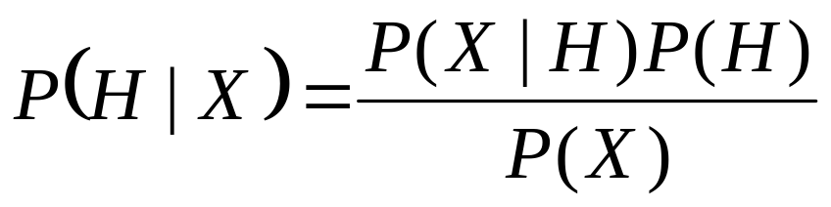
The Bayesian Theorem
In contrast, P(H) is the prior probability of H for any sample, regardless of how the data in the sample looks.
The posterior probability P(H|X) is based on more information then the prior probability P(H).
The Bayesian Theorem provides a way of calculating the posterior probability P(H|X) using probabilities P(H), P(X), and P(X|H).
The basic relation is

Slide 4
The Bayesian Theorem
Suppose now that there are a set of m samples S = {S1, S2, …, Sm} (the training data set) where every sample Si is represented as an n-dimensional vector {x1, x2, …, xn}.
Values xi correspond to attributes A1, A2, …, An, respectively.
Also, there are k classes C1, C2, …, Ck, and every sample belongs to one of these classes.
Given an additional data sample X (its class is unknown), it is possible to predict the class for X using the highest conditional probability P(Ci|X), where i = 1. …, k.

Slide 5
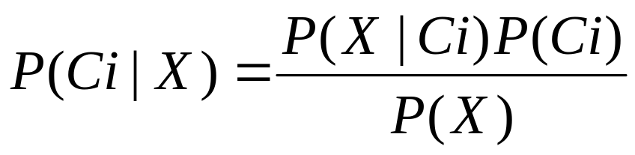
The Bayesian Theorem
That is the basic idea of Naïve-Bayesian Classifier. These probabilities are computed using Bayes Theorem:
As P(X) is constant for all classes, only the product P(X|Ci) · P(Ci) needs to be maximized. We compute the prior probabilities of the class as
P(Ci) = number of training samples of class Ci/m (m is total number of training samples).

Slide 6
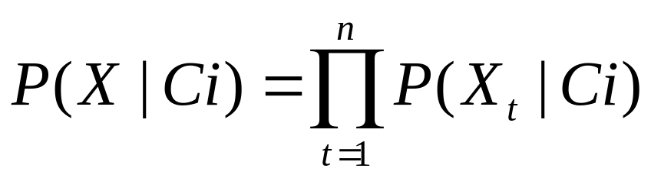
The Bayesian Theorem
Because the computation of P(X|Ci) is extremely complex, especially for large data sets, the Naïve assumption of conditional independence between attributes is made.
Using this assumption, we can express P(X|Ci) as a product:
where xi are values for attributes in the sample X. The probabilities P(X_{t}|Ci) can be estimated from the training data set.

Slide 7
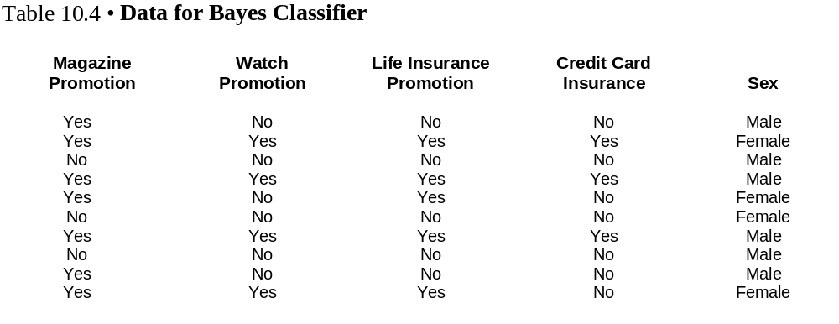
Example Dataset for Naive Bayes Classifier

Slide 8
  Consider the following new sample to be classified:
    Magazine Promotion = Yes
    Watch Promotion = Yes
    Life Insurance Promotion = No
    Credit Card Insurance = No
    Sex = ?

Slide 9
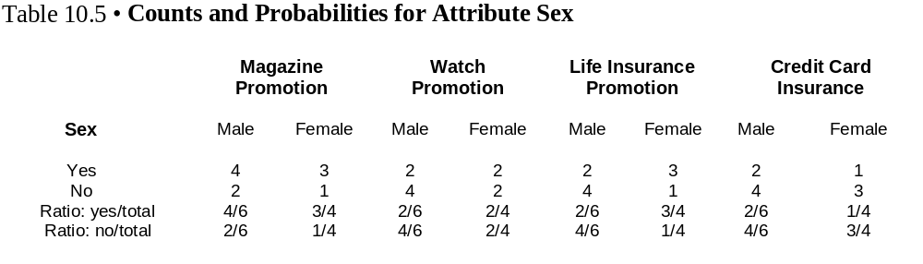
  We have two hypothesis to be tested.
  One hypothesis states the credit card holder is male
  The second hypothesis sees the sample as a female card holder

Slide 10
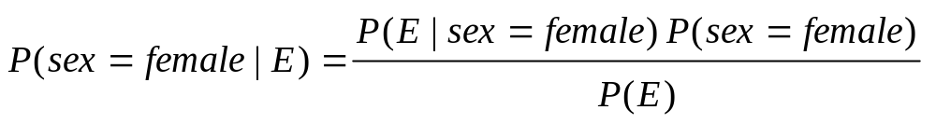

In oreder to determine which hypothesis is correct, we apply Bayes classifier to compute a probability for each hypothesis.

Slide 11
P(sex=female|X)=?
  P(magazine promotion = yes | sex = female) = 3/4
  P(watch promotion = yes | sex = female) = 2/4
  P(life insurance promotion = no | sex = female) = 1/4
  P(credit card insurance = no | sex =f emale) = 3/4
  P(E | sex =female) = (3/4) (2/4) (1/4) (3/4) = 9/128
P(sex = female | E) ≈ (9/128) (4/10) / P(E)
P(sex = female | E) ≈ 0,0281 / P(E)

Slide 12

P(sex=male|X)=?
  P(magazine promotion = yes | sex = male) = 4/6
  P(watch promotion = yes | sex = male) = 2/6
  P(life insurance promotion = no | sex = male) = 4/6
  P(credit card insurance = no | sex = male) = 4/6
  P(E | sex =male) = (4/6) (2/6) (4/6) (4/6) = 8/81
P(sex = male | E) ≈ (8/81) (6/10) / P(E)
P(sex = male | E) ≈ 0,0593 / P(E)

Slide 13
P(sex = male | E) ≈ 0.0593 / P(E)
P(sex = female | E) ≈ 0.0281 / P(E)
Because 0.0593>0.0281, Bayes classifier tells us the sample is most likely a male credit card customer.

